Slide 1
WELCOME TO OUR PRESENTATION
Our Project
“Machine Learning for Predictive Analytics in Healthcare: Patient Appointments and Physician Billing”

Slide 2
Supervisor
Course Teacher
Sondip Poul Singh
Assistant Professor
Department of Computer Science and Engineering
Bangladesh University of Business and Technology
Md. Anwar Hussen Wadud
Assistant Professor
Department of Computer Science and Engineering
Bangladesh University of Business and Technology

Slide 3
Presented by
Parvas Hossain Piash
ID-19202103200
2. Md. Meherab Hossen Apu
ID-192012103199
3. Md. Naeem Islam
ID-19202103182
4. Md. Robiul Islam
ID-19202103175
5. Dolon Roy Chowdhury
ID-19202103171

Slide 4
Agenda
Introduction
Motivation
Objective
Literature Review
Dataset
Proposed Methodology
Result Analysis
Conclusion and Future Work
Reference

Slide 5




Introduction
Simplify the process of scheduling appointments between patients and healthcare providers.
Two key machine learning components: Doctor’s Fee Prediction System and No-Show Prediction Model.
Doctor’s Fee Prediction System analyzes factors like specialization, experience, location, and patient demand to recommend competitive fees.
No-Show Prediction Model forecasts likelihood of missed appointments based on historical data and patient behavior.

Slide 6





Motivation
Improved patient experience
Increased efficiency
Enhanced patient engagement
Enhance convenience and fairness in the appointment process.
Improve resource allocation and reduce no-shows.

Slide 7




Objectives
Create an efficient and user-friendly online platform that allows patients to easily book appointments with doctors.
Provide accurate fee recommendations for fairness and competitiveness.
Leverage historical data and patient behavior to forecast appointment no-shows.
Enable proactive measures to address potential no-shows and optimize schedules.

Slide 8
Related Work (Literature Review)
Yavuz et al. [3] The study evaluates the interface of the mobile Centralized Doctor Appointment System (CDAS), the largest mobile e-government health application in Turkey. The system facilitates citizens in making medical appointments at public hospitals. The evaluation aims to assess the usability and functionality of the CDAS interface, considering its significance in enhancing healthcare access and appointment management for citizens.
Jirabhron et al. [7] Through the application, patients receive automated reminders of their upcoming appointments, helping them stay informed and reducing the likelihood of forgetting or missing their scheduled visits. The system operates on multiple mobile platforms, making it accessible to a wide range of users.

Slide 9

Dataset
We gather information from the data website names Kaggle that already maintain essential records for machine learning.
Links:
Fee Prediction:
We used around 42,000 medical data for implementing the “Fee Prediction” model.
https://www.kaggle.com/code/sagnik1511/doctor-s-fee-prediction-using-random-forest
No-Show Model:
We used around 15,50,000 medical data for implementing the “No-Show” model.
https://www.kaggle.com/datasets/joniarroba/noshowappointments/code?datasetId=792&sortBy=voteCount

Slide 10
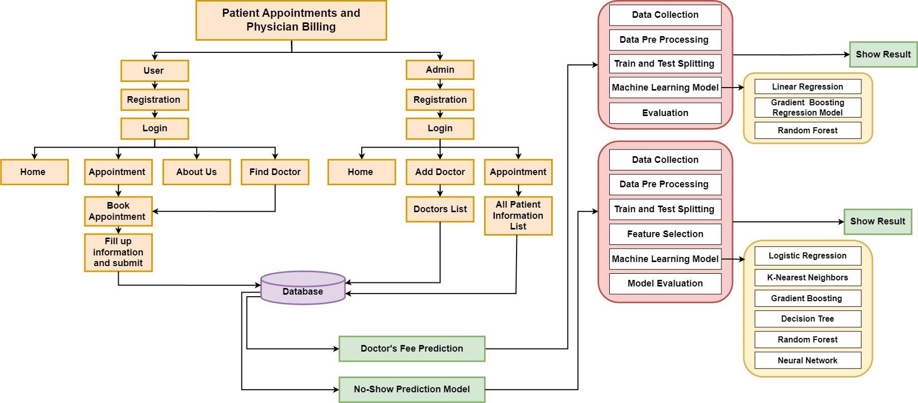
Proposed Methodology

Slide 11
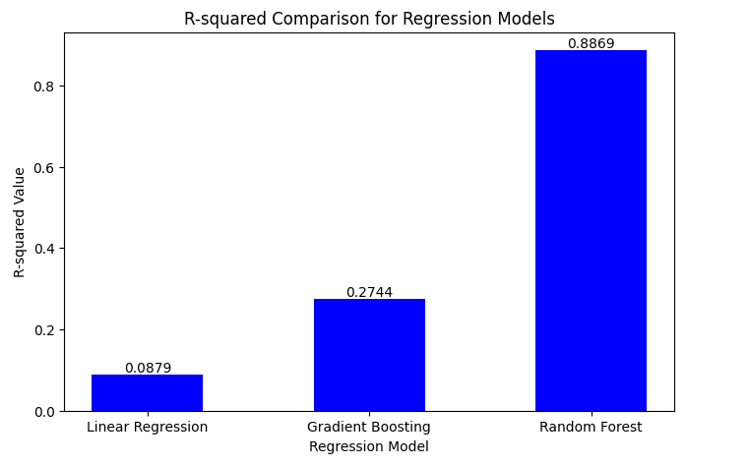
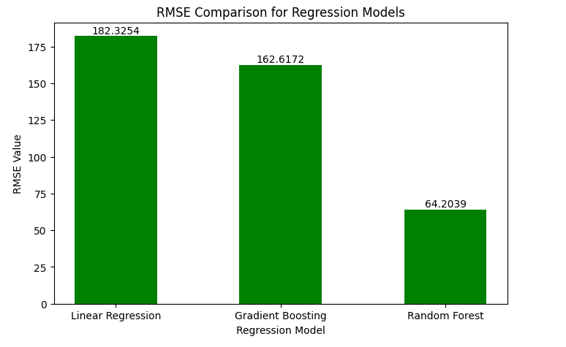
Result Analysis (Doctor’s Fee Prediction System)
Figure : Comparison of R-squared value
Figure : Comparison of RMSE Value

Slide 12
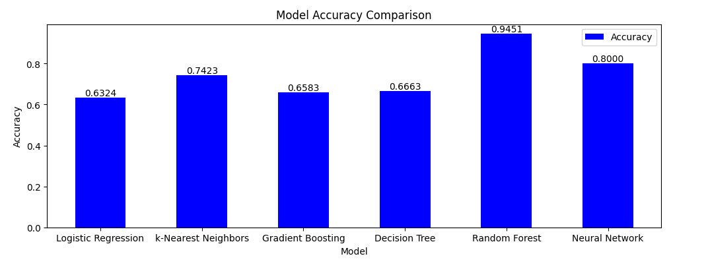
Result Analysis (No Show Model)
Figure : Comparison of no show model accuracy

Slide 13

Future Work
Implement automatic retraining of the Machine Learning model method to adapt to dynamic patient behavior.

Slide 14

Conclusion
Doctor Portal reduces the troubles of people.
People do not need to waste their one day by going to hospital for booking an appointment.
Provides an adaptive and intelligent scheduling solution.

Slide 15
Reference
[3]Yavuz Inal (Department of Information Science and Media Studies, University of Bergen, Bergen, Norway)
[7]J. Chaiwongsai Also published under: Jira Born Chaibongsai, Jirabhron Chaiwongsai School of Information and Communication Technology,University of Phayao,Phayao, Thailand

Slide 16
THANK YOU

